Slide 1
COMMERCE –III ( MF)
Dr. Sumita Shankar

Slide 2

Principles of management

Slide 3
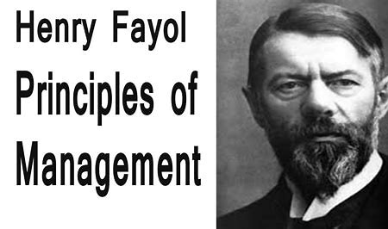

Slide 4
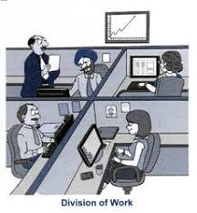
DIVISION OF WORK

Slide 5

AUTHORITY AND RESPONSIBILITY

Slide 6

UNITY OF COMMAND

Slide 7

ESPRIT DE CORPS

Slide 8
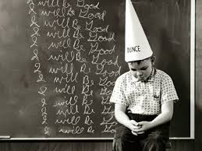
PRINCIPLE OF DICPLINE

Slide 9

UNITY OF DIRECTION

Slide 10

STABILITY OF TENURE

Slide 11
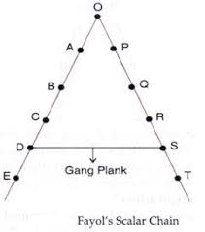
SCLAR CHAIN

Slide 12

ORDER

Slide 13

INITIATIVE

Slide 14

FAIR REMUNERATION

Slide 15
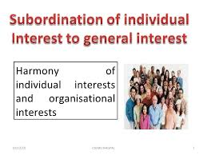
SUB-ORDINATION OF INDIVIDUAL INTEREST TO GENERAL INTEREST

Slide 16

EQUITY AND EQUALITY

Slide 17
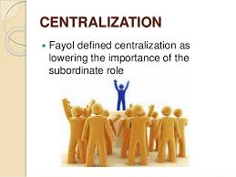
CENTRALISATION

